Slide 1
Student-Paced Sessions are provided to you for offline asynchronous learning.
They are interactive! These presentations will help review and practice concepts you have learned.
These can be taken at your convenience to reinforce your learning

Slide 2
Student-Paced Sessions for
CPJava Class
Units 1, 2 and 3
Please follow these for a more detailed presentations of the topics covered in class. This is provided in addition to the synchronous sessions
Please answer questions as they are posed to you - The session is interactive!

Slide 3
Login to joinpd.com
Use code “sdfkjhdsfkh” to join
Be sure to interact - It counts for your “Practice” assessment!

Slide 4
Topics Covered
Variables and Types
Declarations and Initializations
% (modulus) and integer division
if statements, booleans
Relational and Logical operators
Random numbers
+ and Strings
Methods (aka functions)
Type Cast

Slide 5
The parts of a basic program
Java is picky!
Capitalization matters
Curly braces and semicolons will drive you crazy!
public class MyClass
{
public static void main(String[] args)
{
System.out.println("Hi there!");
}
}

Slide 6
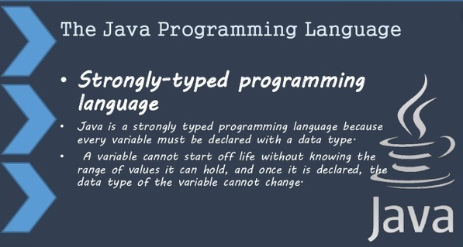
Variables in Java have types
This is different than JavaScript or Python

Slide 7
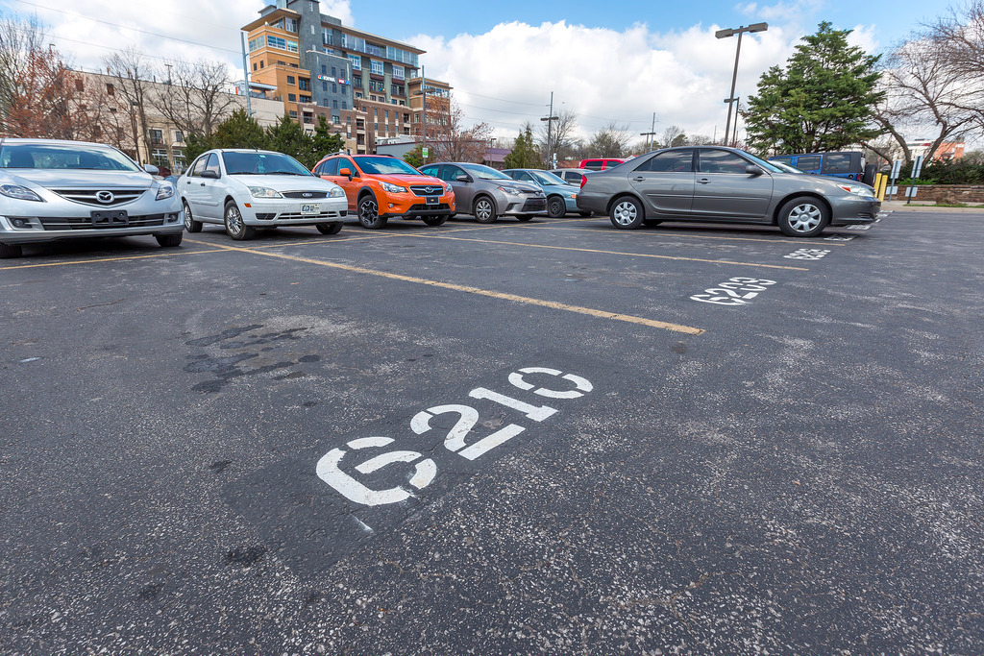
Variables: Parking space analogy
Like a parking space, a variable can store a value (think vehicle) until you need it later

Slide 8
Variables: Parking space analogy
Parking spaces are often labeled so you can find your car later when you need it
Let's say that G210 is the name of this parking space

Slide 9
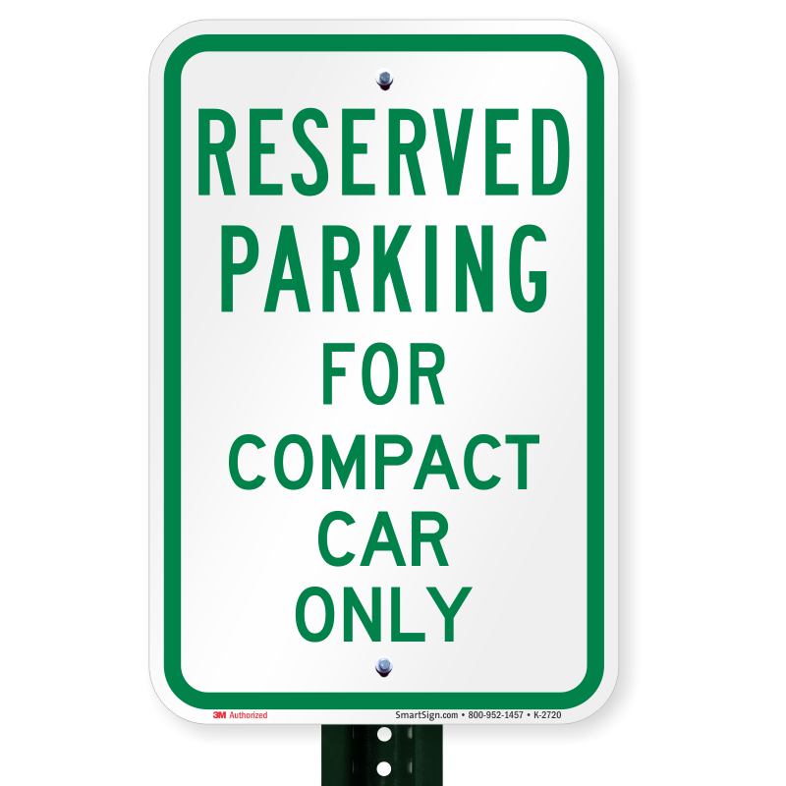
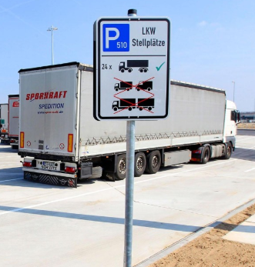

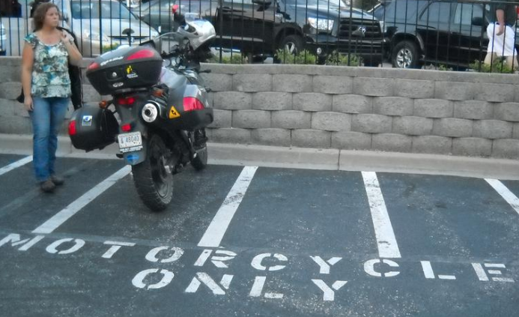
Variables: Parking space analogy
In addition to a name, parking spaces can have a type that sets size limits

Slide 10
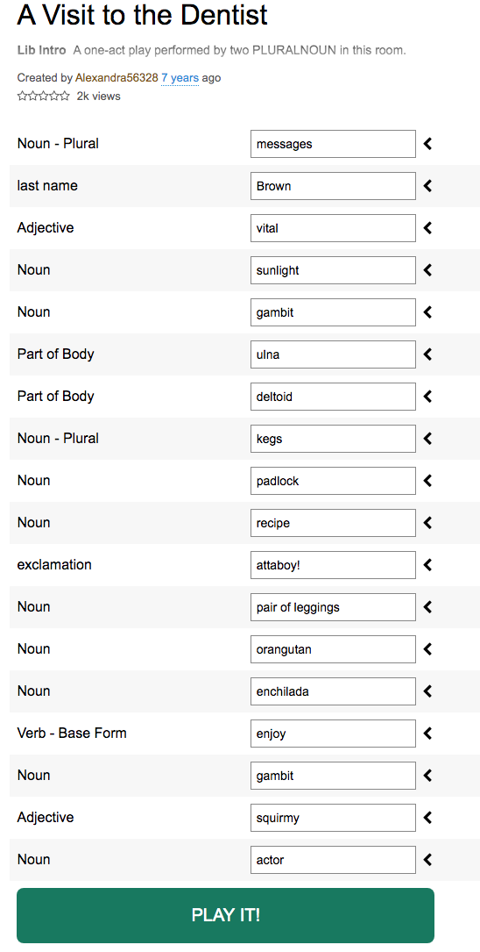
Variables: MadLib analogy
The blank in a MadLib is like a Java variable
The blank is a space that can hold different words
Each blank has a type: noun, verb, adjective or adverb
Try it!

Slide 11
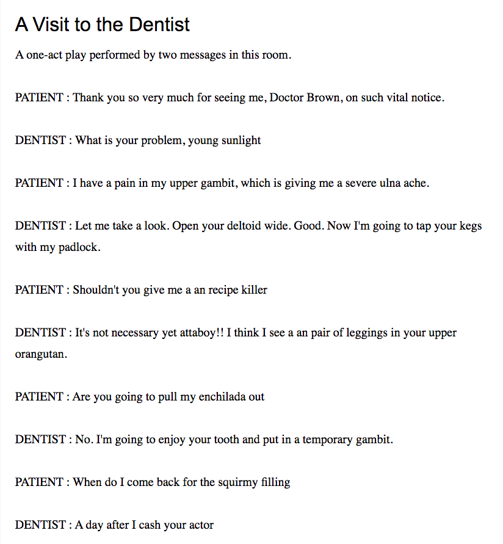
Madlib Hilarious Result!

Slide 12
Primitive data types
In Java (unlike Python or JavaScript) variables have types
Each type has size limits
For this class, you need to know 5 basic (aka “primitive”) types:
int
float
double
boolean
char

Slide 13
Primitive data types
int holds a single integer value between -2,147,483,648 and 2,147,483,647
float a decimal value with up to 7 digits
double a decimal value with up to 15 digits
A boolean can only hold values that evaluate to either true or false
char holds a single letter, digit, space or punctuation mark and must be enclosed in single quotes, like this: 'G'

Slide 14
A Java variable declaration
The Java statement that creates a variable is called a declaration
Here’s an example declaration
int num;
The first word of the declaration is the type
The second word is the name that the programmer choose
The semicolon marks the end of a Java statement much like a period in English

Slide 15
Variable names and keywords
You can pretty much choose any name you want for a variable with a few limitations:
Variable names cannot
start with a number
contain a space
have a special meaning in Java
Java has about 50 reserved words or keywords that you are not allowed to use as variable names such as public, class, static, void, int …

Slide 16
camelCase
Because a Java variable name can’t have spaces, a style called camelCase is usually used for variable names with more than one word
camelCase capitalizes the first letter of each word except the first word
Examples: firstName, numberOfDogs
Java variable names are case-sensitive, so firstName is not the same as firstname or FirstName.

Slide 17
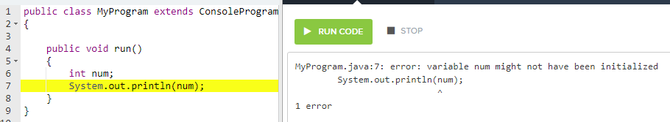
What’s the error?

Slide 18
Variable initialization
After a Java variable is declared, it needs to be initialized

Slide 19
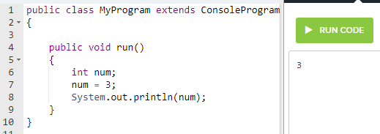
Variable initialization
The English word “initial” means first
We initialize a variable by assigning (“setting it equal to”) its first value

Slide 20
Declare and initialize
You can declare and initialize a variable with one line of code:
int num = 3;
Just remember that the one line of code is doing two different steps: the declaration and the initialization

Slide 21
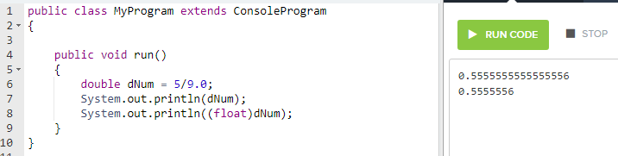
float vs. double
float is short for floating point, another name for decimal point
double gets its name because of its size, it has about twice as many digits as a float

Slide 22
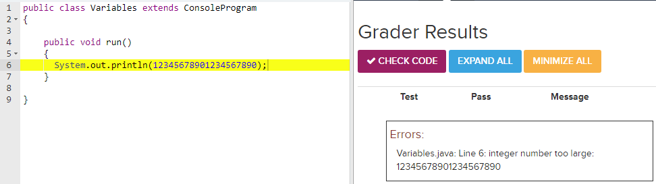
What is the error?

Slide 23
What is the error?
We are trying to print an integer that is too large for Java’s integer size

Slide 24
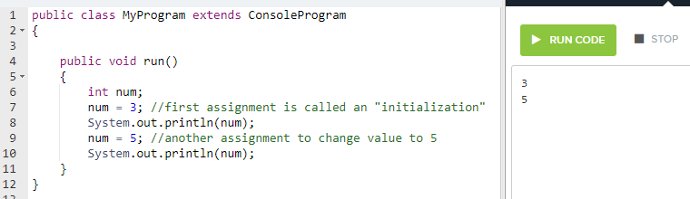
Assigning a value to a variable
Changing the value of a variable is called an assignment
We do this with the equals sign =
In Java we call the (single) equals sign the assignment operator

Slide 25
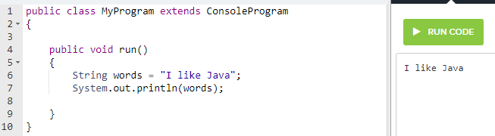
String variables
A String variable can store text with any number of letters, digits, punctuation marks and spaces
The beginning and end of the text is marked with double quotes (")

Slide 26
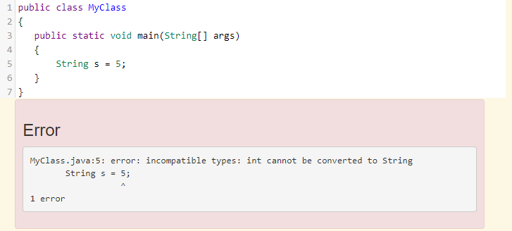
What is the error?
The types String and int don’t match

Slide 27
Arithmetic operators
+ - * / %
Addition
Subtraction
Multiplication
Division
Modulus (also called Mod or Modulo) calculates the remainder of dividing two integers
It turns out that Modulus is extremely useful in loops and iterations!

Slide 28
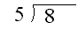
Modulus and integer division
Remember how you did math in grade school?
30

Slide 29
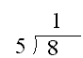
Modulus and integer division
Remember how you did math in grade school?
31

Slide 30
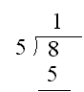
Modulus and integer division
Remember how you did math in grade school?
32

Slide 31
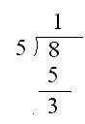
Modulus and integer division
Remember how you did math in grade school?
33

Slide 32
Modulus and integer division
The modulus operator gives the remainder of an integer division expression
8/5
8%5
34

Slide 33
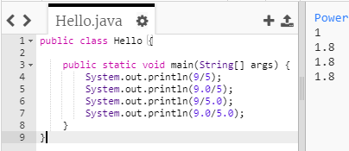
integer vs. decimal division
Java does division differently depending on the types of numbers
When the types are mixed, the Java uses the larger type

Slide 34
Modulo Clock Widget
Evaluate these modulus expressions in Java. You may find the Modulo Clock Widget at www.yellkey.com/another helpful
27 % 5
9 % 4
21 % 2
5 % 8

Slide 35
Modulo Clock Widget
27 % 5

Slide 36
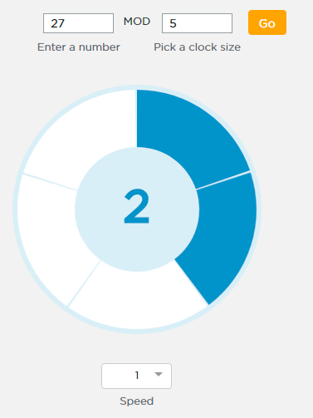
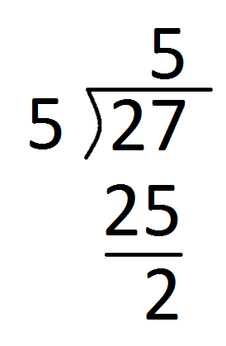
Modulo Clock Widget
27 % 5

Slide 37
Modulo Clock Widget
9 % 4

Slide 38
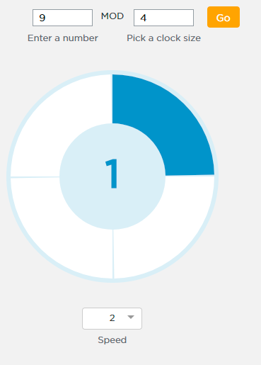
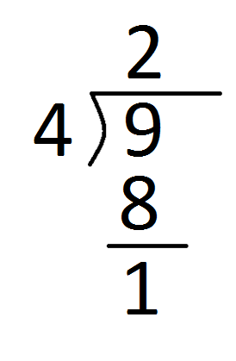
Modulo Clock Widget
9 % 4

Slide 39
Modulo Clock Widget
21 % 2

Slide 40
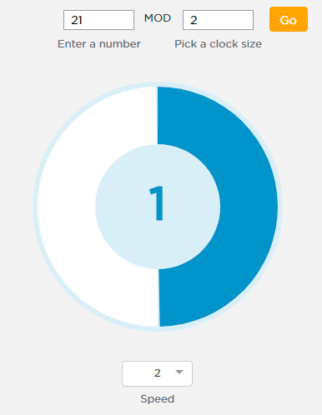
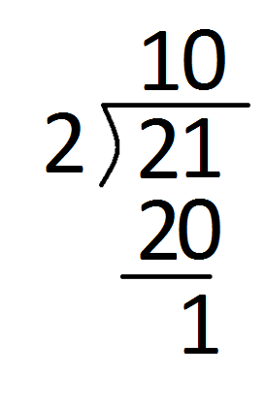
Modulo Clock Widget
21 % 2

Slide 41
Modulo Clock Widget
5 % 8

Slide 42
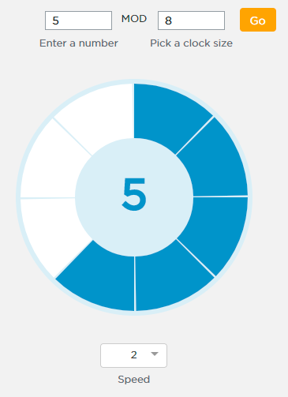
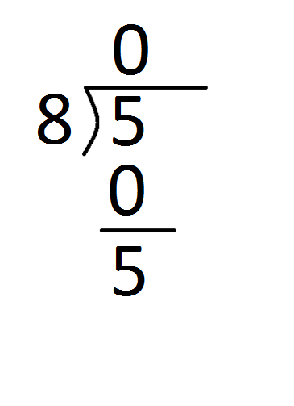
Modulo Clock Widget
5 % 8

Slide 43
Modulo Clock Widget
Now see if you can answer these questions on your own without using the widget
HINT: all of these are kind of easy if you understand how Modulo works - don't be fooled by the big number on the first one
24 % 817234
24 % 23
15 % 4

Slide 44
Math.random()
The AP exam uses Math.random() to generate random decimals
Math.random() returns a double between 0 and 1 (including 0 but not 1)
While there are other ways to make random numbers in Java, you will only be tested on Math.random()

Slide 45
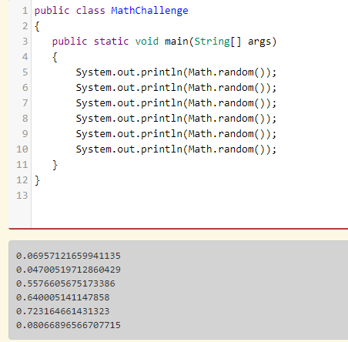
Math.random()
Notice that each call to Math.random() produces a different random decimal

Slide 46
Cast
Java is strongly typed
This means it's very strict about data types
It won't let you do store a decimal in an int variable for example
int nNum = 5.6;
To fix it you need a cast:
int nNum = (int)5.6;
The cast tells Java just this once, treat it as if it were an int

Slide 47
float vs. double
Java has two types of decimals: float and double
double got its name because it can store roughly 2x as many digits as float
For this class you will find that we need to know both

Slide 48
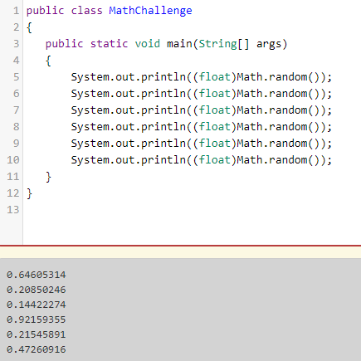
(float)Math.random()

Slide 49
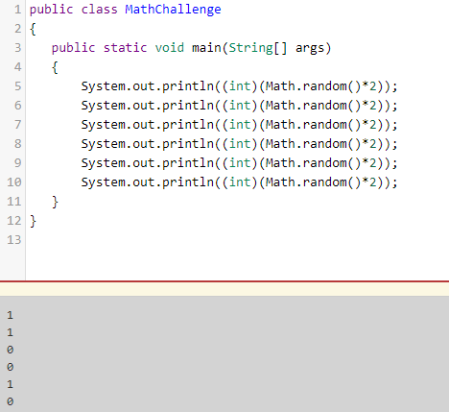
(int)(Math.random()*2)
A random int that is either 0 or 1

Slide 50
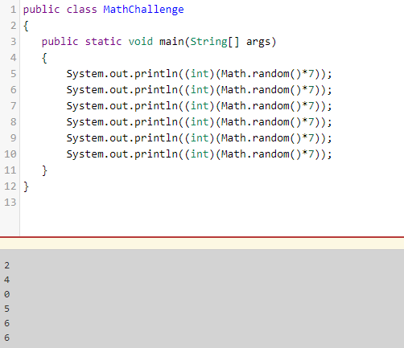
(int)(Math.random()*7)
A random int in the range {0,1,2,3,4,5,6}

Slide 51
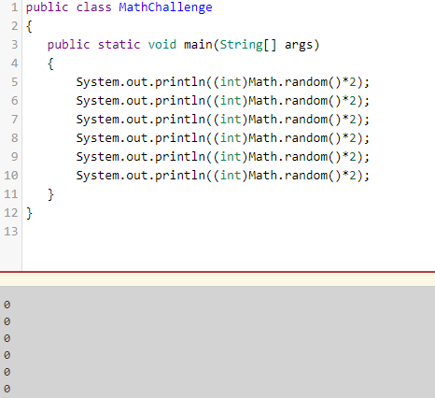
Watch out for this mistake!
Why is the output always zero?

Slide 52
Watch out for this mistake
(int)Math.random()*2 always evaluates to zero because Java works left to right just like math
The yellow cast is applied before the green multiplication

Slide 53
Watch out for this mistake
(int)Math.random()*2
Since Math.random() is cast as an int before being multiplied, the result is always zero
The fix:
(int)(Math.random()*2)

Slide 54
Problem: Generate a random integer between 0 and 101 (including 0 up to but not including 101)
First we need a random decimal:
Math.random() * 101
Gives a random decimal between 0.0 and 100.9999. . .
(int)(Math.random()*101)
Gives a random integer between 0 and 100 inclusive

Slide 55
Some of the hardest Math.random() problems are when you need a random integer in a range that doesn’t start with zero.
For example: Create a random integer in the range {3,4,5,6,7,8,9,10}

Slide 56
Problem: Create a random integer in the range {3,4,5,6,7,8,9,10}
First, we'll solve a simpler problem—subtract 3 so we start at zero

Slide 57
Problem: Create a random integer in the range {3,4,5,6,7,8,9,10}
First, we'll solve a simpler problem—subtract 3 so we start at zero
That, is, a random integer from 0 to 8 (including 0 but not 8)
(int)(Math.random() * ??)

Slide 58
Problem: Create a random integer in the range {3,4,5,6,7,8,9,10}
First, we'll solve a simpler problem—subtract 3 so we start at zero
That, is, a random integer from 0 to 8 (including 0 but not 8)
(int)(Math.random() * 8)

Slide 59
Problem: Create a random integer in the range {3,4,5,6,7,8,9,10}
Now, add 3 to shift the range back up
(int)(Math.random() * 8) + 3

Slide 60
End of Unit 2

Slide 61
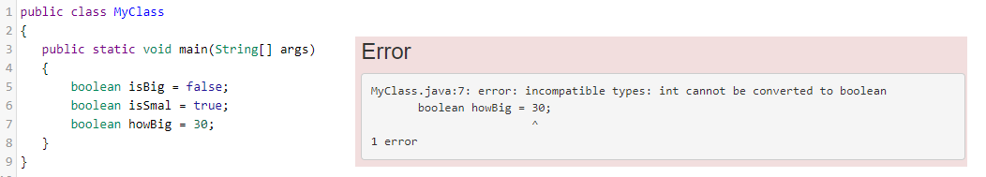
boolean variables
booleans are Java’s simplest and smallest primitive type
booleans can only store true or false, nothing else
Here I’m getting an error because I’m trying to assign an integer to a boolean variable

Slide 62
boolean vs. String
true and false are booleans
"true" and "false" are Strings
Beginning Java programmers are often confused by the difference
To Java, anything in double quotes is a String which, to Java, is completely different than a boolean

Slide 63
Logical operators
&& || !
And
Or
Not
Logical operators are sometimes also called Boolean operators
Logical operators combine multiple booleans into expressions that evaluate to a single true or false

Slide 64
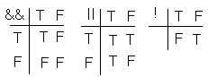
Truth Tables
Truth tables show the results combining booleans with && || or !
Evaluate each expression:
false || true
true && false
!true

Slide 65
Truth Tables
Truth tables show the results combining booleans with && || or !
Evaluate each expression:
false || true is true
true && false is false
!true is false

Slide 66
Relational (Comparison) Operators
> >= < <= != ==
Is Greater Than
Is Greater Than or Equal
Is Less Than
Is Less Than or Equal
Is Not equal
Is Equal to

Slide 67
Logical Operators
What would be printed?
int nCount = 150;
System.out.println((0<nCount)&&(nCount<=100));

Slide 68
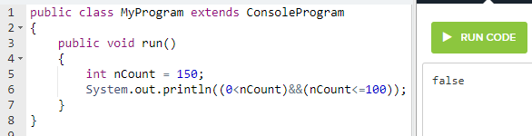
Logical Operators
What would be printed? false
int nCount = 150;
System.out.println((0<nCount)&&(nCount<=100));

Slide 69
Logical Operators
Now what would be printed?
int nCount = 50;
System.out.println((0<nCount)&&(nCount<=100));

Slide 70
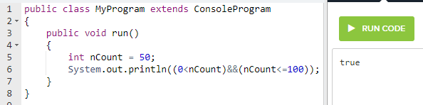
Logical Operators
What would be printed? true
int nCount = 50;
System.out.println((0<nCount)&&(nCount<=100));

Slide 71
Logical Operators
Lets assign nCount 150 and replace the and with an or. Now what will be printed?
int nCount = 150;
System.out.println((0<nCount)||(nCount<=100));

Slide 72
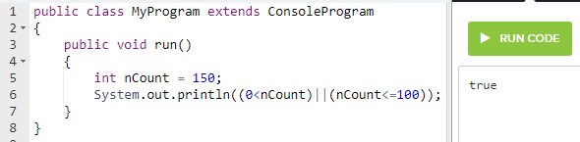
Logical Operators
Lets assign nCount 150 and replace the and with an or. Now what will be printed? true
int nCount = 150;
System.out.println((0<nCount)||(nCount<=100));

Slide 73
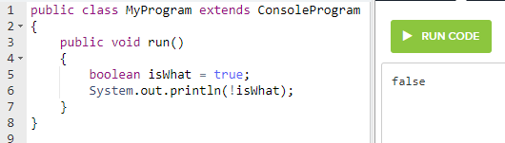
! The NOT Operator
In Java, ! is pronounced “not”
It gives the opposite of whatever boolean comes after it
boolean isWhat = true;
System.out.println(!isWhat);

Slide 74
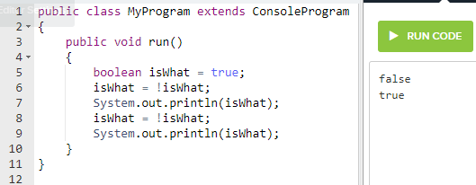
! The NOT Operator
! is much more important than you would expect
We’ll frequently use ! to “flip” a boolean from true to false and back

Slide 75
Short circuit evaluation
true || anything is always true, so Java does not need to evaluate the expression anything
Likewise, false && anything is always false
Ignoring the anything, when possible, is called short circuit evaluation

Slide 76
Short circuit evaluation
What does -3 < 0 || 567*2-17/3==1128 evaluate to?
true
Its not necessary to evaluate the second condition because the first condition is true and true || anything is always true

Slide 77
Short circuit evaluation
What does 1==0 && 274/17 > 7846/461 evaluate to?
false
Its not necessary to evaluate the second condition because the first condition is false and false && anything is always false

Slide 78
Distributing the !
The rules for distributing the ! are known as De Morgan’s laws
!(A && B) is the same as !A || !B
!(A || B) is the same as !A && !B

Slide 79
Distributing the !
More examples of De Morgan’s laws
!(x < 5 && y == 3)
is the same as
x >= 5 || y != 3
!(x >= 1 || y != 7)
is the same as
x < 1 && y == 7

Slide 80
How would Java evaluate these expressions?
char cGrade = 'B';
('A' <= cGrade) && (cGrade <= 'F')

Slide 81
How would Java evaluate these expressions?
char cGrade = 'B';
('A' <= cGrade) && (cGrade <= 'F')
//true

Slide 82
How would Java evaluate these expressions?
char cGrade = 'B';
('A' <= cGrade) && (cGrade <= 'F')
//true
int nAge = 16;
! (19 >= nAge && nAge >= 13)

Slide 83
How would Java evaluate these expressions?
char cGrade = 'B';
('A' <= cGrade) && (cGrade <= 'F')
//true
int nAge = 16;
! (19 >= nAge && nAge >= 13)
//false

Slide 84
How would Java evaluate these expressions?
char cGrade = 'B';
('A' <= cGrade) && (cGrade <= 'F')
//true
int nAge = 16;
! (19 >= nAge && nAge >= 13)
//false
int nAge = 16;
19 < nAge || nAge < 13

Slide 85
How would Java evaluate these expressions?
char cGrade = 'B';
('A' <= cGrade) && (cGrade <= 'F')
//true
int nAge = 16;
! (19 >= nAge && nAge >= 13)
//false
int nAge = 16;
19 < nAge || nAge < 13
//false

Slide 86
if statements
If the condition in parentheses is true, the code in the curly braces (called a block) executes
if (x > 0) {
System.out.println("x is positive");
}

Slide 87
if else statements
If the condition in parentheses is true, the code in the first block executes otherwise the second block executes
if (x > 0) {
System.out.println("x is positive");
}
else {
System.out.println("x is NOT positive");
}

Slide 88
if else if statements
The block under the first true condition runs, and then all other blocks are skipped
If all conditions are false, the else block runs
if (temp > 80) {
System.out.println("Hot");
} else if (temp > 65) {
System.out.println("Warm");
} else if (temp > 50) {
System.out.println("Cool");
} else {
System.out.println("Cold");
}

Slide 89
if statements
Curly braces are optional if a block has only one statement
if (x > 0) {
System.out.println("x is positive");
}
is the same as
if (x > 0)
System.out.println("x is positive");

Slide 90
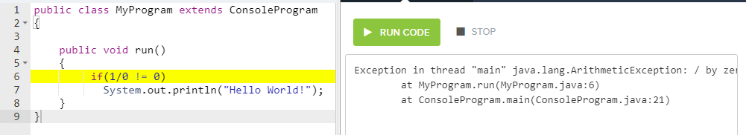
More short circuit evaluation
Notice that Hello World! is not printed because of the divide by zero exception in the if(1/0 != 0)

Slide 91
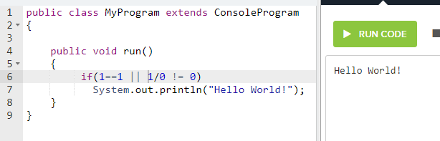
More short circuit evaluation
Now Hello World! is printed and there is no divide by zero exception
Because 1==1 || anything is true, Java does not execute the code that would cause an exception

Slide 92
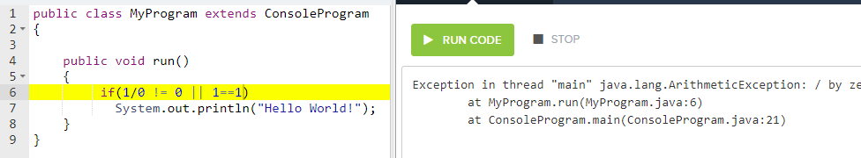
Order matters!
In this version, the code that causes the exception executes first so Hello World! is not printed

Slide 93
== vs. .equals() for Strings
== checks if the String variables refer to the same String
.equals checks if two different Strings have the same characters

Slide 94
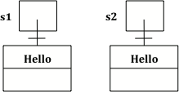
== vs. .equals() for Strings
s1 and s2 refer to two different new Strings
String s1 = new String("Hello");
String s2 = new String("Hello");
System.out.println(s1 == s2);
System.out.println(s1.equals(s2));

Slide 95
== vs. .equals() for Strings
s1 == s2 is false because the two Strings are different
String s1 = new String("Hello");
String s2 = new String("Hello");
System.out.println(s1 == s2); //false
System.out.println(s1.equals(s2)); //true

Slide 96
== vs. .equals() for Strings
s1.equals(s2) is true because the two different Strings have the same characters
String s1 = new String("Hello");
String s2 = new String("Hello");
System.out.println(s1 == s2); //false
System.out.println(s1.equals(s2)); //true

Slide 97
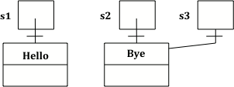
== vs. .equals() for Strings
s2==s3 and s2.equals(s3) are both true because they are the same String with the same characters
String s2 = new String("Hello");
String s3 = s2;
System.out.println(s2 == s3); //true
System.out.println(s2.equals(s3)); //true

Slide 98
== vs. .equals() for Strings
s1==s2 and s1.equals(s2) are both false because they are different Strings with different characters
String s1 = new String("Hello");
String s2 = new String("Bye");
System.out.println(s1 == s2); //false
System.out.println(s1.equals(s2)); //false

Slide 99
Null pointer error
Uninitialized Strings are null
You get a null pointer error when you try to use an uninitialized String
String s1; //unitialized
String s2 = new String("Hello");
System.out.println(s1); //null
System.out.println(s1.equals(s2));
//error

